Slide 1
Stacks and Queues
CS 580U Fall 2018

Slide 2
ADTs describe behavior
Data structures are the implemented structures that manage data
Abstract Data Type’s describe behavior, not implementation
A Data Structure is an implementation of an ADT and should have a conventional interface, but implementation can vary greatly

Slide 3
Stacks
A Sequential Collection
Sequential
Order of element insertion matters
Collection
Used to group items of the same type
Purpose is to restricts how the data is accessed, not how the data is stored
Provides access control through encapsulation

Slide 4
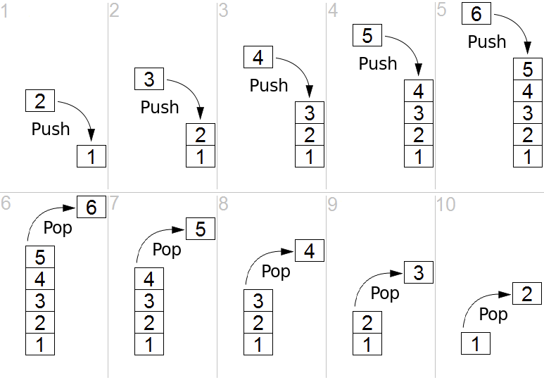
LIFO
Example: Stack of Books
Last in First Out
The order items are inserted and removed
Stacks limit the user to removing elements in reverse order of their arrival

Slide 5
Examples of Stack
Stack of Books
Undo in a word processor
The function stack

Slide 6
Push / Pop
Push
Inserting onto a stack is called a push
You can imagine pushing everything in the stack down
Pop
Removing from the stack is called pop
Every element in the stack pops up whenever you remove an element
To access an element, you must take every element before it off the stack

Slide 7
Stack Public Interface
struct Stack { // Stack struct ADT
int length; // Return the number of elements in the stack Collection items;
}
void clear(Stack *); // Reinitialize the stack. int push(Stack *, Data d); // Push "d" onto the top of the stack Data pop(Stack *); // Remove and return the element at the top of the stack Data peek(Stack *); // Return a copy of the top element

Slide 8
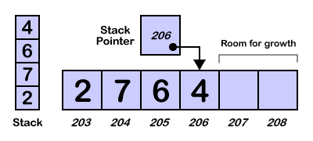
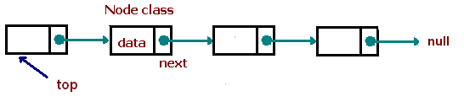
Two Implementations
Array Based
top - an index pointing to the ‘top’ of the list
the top of the stack is the end of the list
the initialization size
pros
easier memory management
cons
requires a static size
Linked Based
Can use your existing linked list as the underlying data structure
pros
internal memory is dynamic
cons
more complex memory management

Slide 9
Queues
Another Collection Data Structure
Purpose is also to restrict how the data is accessed
Provides access control through encapsulation
A Sequential data structure
Order of element insertion matters

Slide 10
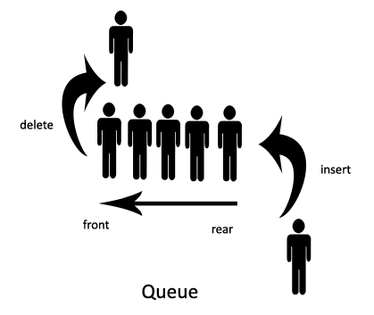
FIFO
First In First Out
queues remove elements in the order of their arrival
Example
Grocery Store Lines
The input/output buffer

Slide 11
Dequeue / Enqueue
Enqueue
Inserting onto a queue is called a enqueue
You can imagine the data getting in line
Dequeue
Removing from the stack is called dequeue
Every element in the stack moves up whenever you remove an element
To access an element, you must take every element before it off

Slide 12
Queue Public Interface
struct Queue { // Stack class ADT
int length; // Return the number of elements in the stack
}
void clear(Queue *); // Reinitialize the stack.
int enqueue(Queue *, Data d); // Push "d" onto the top of the stack
Data dequeue(Queue *); // Remove and return the element at the top of the stack
Data peek(Queue *); // Return a copy of the top element

Slide 13
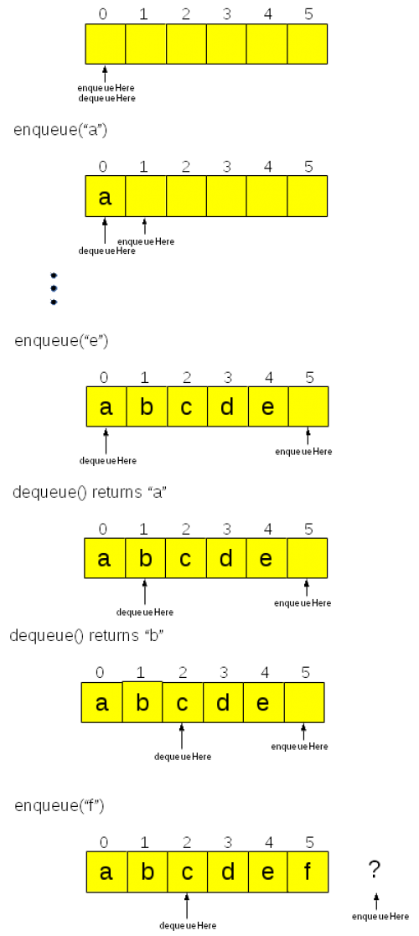
Array Based Queue Implementation

Slide 14
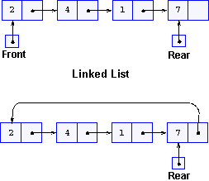
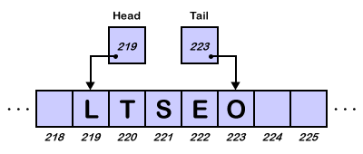
Two Implementations
Array Based
top and bottom - an index pointing to the ends of the list
need initial size
the initialization size
pros
easier memory management
cons
requires a static size
Linked Based
Can use your existing linked list as the underlying data structure
pros
internal memory is dynamic
cons
more complex memory management

Slide 15
Classwork:
Stacks and Queues

